Slide 1
PULMONOLOGY
FRIDAY CASE CONFERENCE
Sudhesh Kumar, MS5
David Farrier, PGY2
Danny Witt, PGY2
Alex Ticho, PGY2
Michael Storandt, PGY2
Fellow: Hassan Albitar, PGY6
Consultant: Dr. Olson

Slide 2
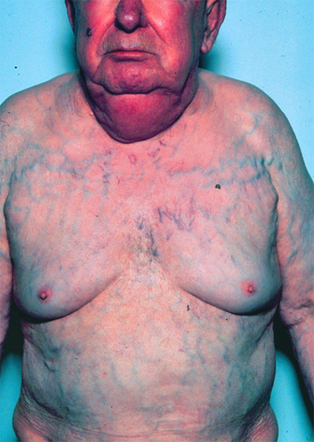
HPI
73M presenting with worsening SOB and prominent veins on the chest and facial redness
Pertinent past medical history
Suspected idiopathic fibrosing mediastinitis since 2016
Multifocal stenosis in pulmonary artery (s/p stent 2017), pulmonary vein (s/p dilation 2019), & SVC (s/p stent 2016 and 2022)
Afib and AV block (s/p leadless pacemaker implantation 2022)
Meds
Eliquis
Low dose prednisone

Slide 3
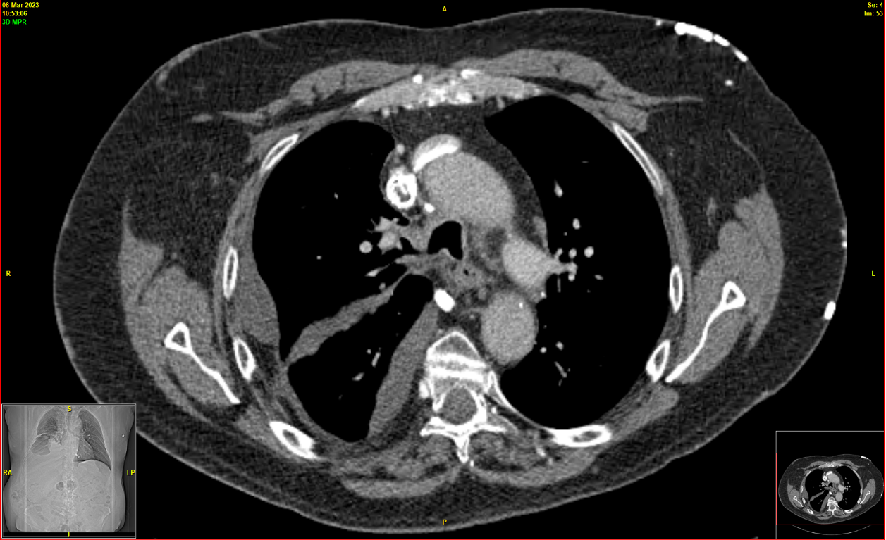
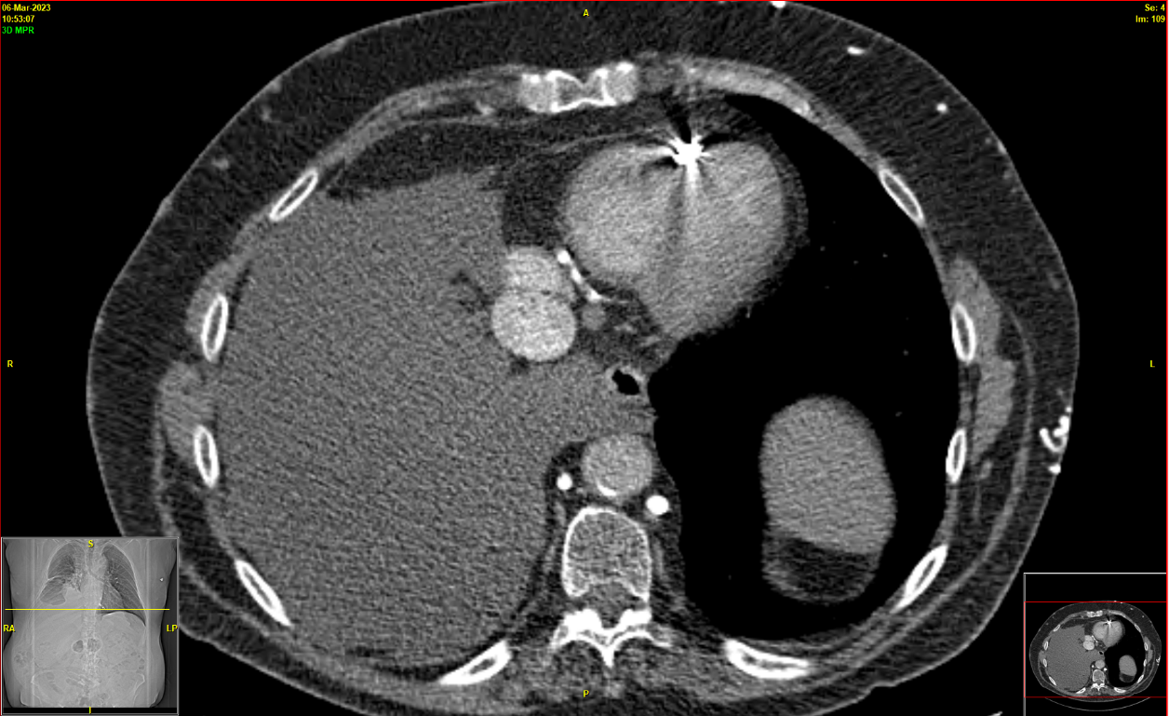
WORKUP
CT scan (3/2023)
Near complete thrombosis of SVC stent
Loculated right pleural effusion
Irregular mass abutting the right atrium, ascending aorta and anterior chest wall.

Slide 4
WORKUP
Pleural fluid analysis (3/2023)
Protein 3.7
Cholesterol 73
Triglycerides 1015
Glucose 131
Culture negative
Echo (3/2023)
External compression at the level of the tricuspid valve annulus (gradient of 3-5 mmHg)
RVSP 40 mmHg
FNA (2019) – fibroinflammatory proliferation
Culture from mediastinal tissue (2019) - negative for TB and fungus
PET-CT (2021) showed soft tissue anterior mediastinal mass with SUV max of 13.87
Lung Ventilation and Perfusion (2022) - Moderate decreased perfusion of the right upper and middle lobes likely 2° pulmonary artery narrowing

Slide 5
CHYLOTHORAX
Etiology
Post-surgery most common - Esophagectomy and pulm resection
Malignancy – lymphoma
Presentation
SOB, cough, and chest discomfort
Chylous ascites and rarely, chyloptysis
Diagnosis
Pleural fluid triglyceride level > 110 mg/dL
Lymphangiography
Quantification
< 500 mL/day - conservative management
> 500 mL/day for 5 to 7 days or any volume for 2 weeks – aggressive

Slide 6
MANAGEMENT
Conservative – low output
A low- or no-fat diet (< 10 g fat/day) – esp long chain triglycerides
Somatostatin
Thoracentesis or chest tube placement
Aggressive intervention – high output or persistent
Thoracic duct ligation
Pleurodesis
Pleuroperitoneal or pleurovenous shunts
Thoracic duct embolization
Thoracic duct disruption
Indwelling pleural catheters
Notes:
Low fat 1- the idea 2- long chain 3- npo 4- dietician
Somatostatin 1- the idea 2- adjunct

Slide 7
FIBROSING MEDIASTINITIS
Etiology
Histoplasmosis
TB, Sarcoidosis, Irradiation
Idiopathic
Presentation - compressive
Pulmonary vascular obstruction – PA, PV hypertension
SVC syndrome
Postobstructive pneumonia or atelectasis
Esophageal compression
Diagnosis
CT with contrast
Biopsy – usually not done
Notes:
leakage of fungal antigens (not the organism itself) from lymph nodes into the mediastinal space, leading to a hypersensitivity reaction followed by an exuberant fibrotic response
dense infiltrative heterogeneous mediastinal process that obliterates fat planes, with or without a discrete mass
For many patients, fibrosing mediastinitis needs to be differentiated from other causes of a mediastinal mass. This includes benign causes such as mediastinal granuloma or malignancies such as bronchogenic cancer and lymphoma. Sclerosing lymphoma is a particularly aggressive form of B cell lymphoma that may mimic fibrosing mediastinitis. However, most patients with malignancies of the mediastinum have a relatively faster clinical course of progression and lack calcification on imaging in the mass or lymph nodes, which is more typical of fibrosing mediastinitis. In contrast, mediastinal fibrosis tends to be more slowly progressive, have calcifications, and give the appearance of "creeping" as the fibrosis tracks along vascular planes.

Slide 8
MANAGEMENT
No curative therapy
Vascular stents
Airway dilation and placement of an airway stent
Anti-fungal therapy not recommended.
Steroids sometimes in autoimmune/sarcoidosis-related mediastinitis
Surgery – with high morbidity and mortality
SVC bypass surgery
Resection of the stenotic airway and/or the distal lung parenchyma

Slide 9
HOSPITAL COURSE
Underwent catheter aspiration of SVC stent
A portion of the clot got dislodged, resulting in a PE and ICU transfer
Status eventually improved with anti-coagulation and diuresis
Kept on low-fat diet and octreotide
Was discharged in a stable condition and follow up with vascular medicine and IR.

Slide 10
QUESTIONS & ANSWERS

